Slide 1
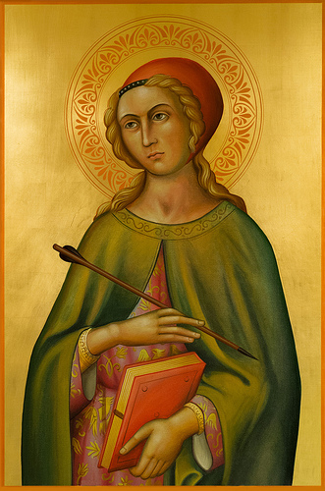
SHE WAS BORN AND DIED IN THE 3rd CENTURY HER FEASTDAY IS JULY 24th
Saint Christina of Bolsena
She lived during the Age of Martyrs (3rd Century)
It was a age of persecution for the Church
On her path to holiness, her choices impacted all parts of her life
She was not canonized by the Church, but she was recognized as a saint from the Catholic community
1, 4

Slide 2
The Life of Saint Christina
She lived during the third century and was the daughter of a rich and powerful magistrate named Urbain. He practiced heathenism and had golden idols which he distributed among the poor.
She had drawn the eye of several suitors at the age of 11-years-old. However, Urbain wanted her to be a pagan priestess.
Urbain locked her in a room filled with gold and silver idols. He then ordered her to burn incense before them.
She often peered at the world outside and decided there must be a great creator of the world. She came to believe that the idols could only be false as they were forged by man.
4

Slide 3
The Life of Saint Christina (continued)
She began to pray to the creator of the world and asked him to reveal himself to her. She felt an intense love blaze from within her heart. She began to fast and continued to pray.
An angel came to St. Christina and taught her the Gospel of Christ. It then called her a bride of Christ but warned she would suffer for her faith.
She smashed the false idols and threw them out the window. When her father came to visit and discovered the missing idols, he questioned her but she refused to speak to him.
Urbain learned of her new faith. He began to slap her face until she began to speak. She proclaimed her new faith and shared the Truth. She admitted to destroying the idols.
4

Slide 4
The Life of Saint Christina (continued)
Urbain beat her before throwing her into prison. Her mother came to the prison and pleaded for her daughter to renounce her faith, but she refused.
The next day, Urbain took St. Christina to trial and ordered her to worship the pagan gods and beg for forgiveness.
Rather than following her father's orders, St. Christina held fast to her Christian faith and was ordered to be tortured.
She was raked through flames. Her body was burned but she did not die. That night, an angel appeared to her in her prison cell. Her wounds were healed by the angel.
4

Slide 5
The Life of Saint Christina (continued)
When her father found her unharmed, he ordered a millstone to be tied around her neck and she was thrown into a lake. As she sank, an angel sustained and untied her. When she reappeared above the water, Urbain attributed her survival to sorcery.
.
He decided to execute her the following morning but he died suddenly that night.
While in her cell, she converted nearly 300 people. A new governor arrived and resumed her torture. She survived five days in a red-hot furnace and was finally executed when she was shot in the heart with an arrow.
The region's governor was sent to execute St. Christina's punishment in place of her father, but she survived every torture. When fellow believers heard of the miracles, they began to gather at her cell.
.
Saint Christina is a saint because she is a Virgin Martyr
4

Slide 6
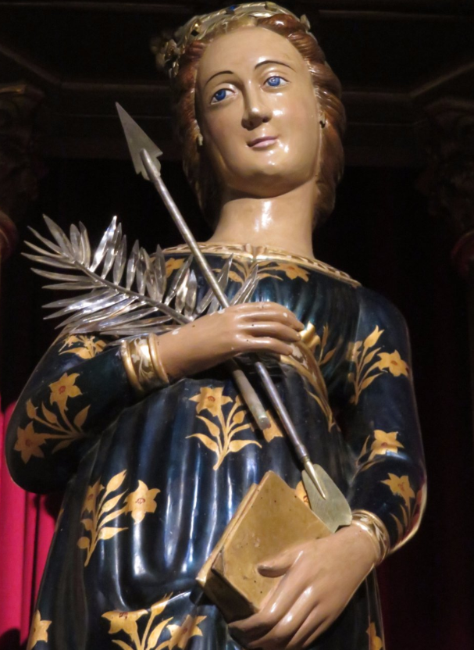
martyr, n. 1. A martyr is someone who suffers persecution and death for advocating, renouncing, refusing to renounce, or refusing to advocate a belief or cause as demanded by an external party.
MARTYRS = IDEAL DISCIPLES
Martyrs…
Are ones who follow Christ even to the point of death in imitation of Him.
Sacrificial deaths give WITNESS to faith in the life, death, and resurrection of Jesus.
1, 6, 7

Slide 7
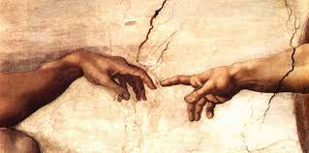
“As he who called you is holy, be holy yourselves in every aspect of your conduct, for it is written, “Be holy because I [am] holy.” 1 Pet. 1:15-16
By martyrdom a disciple is transformed into an image of his Master by freely accepting death for the salvation of the world Lumen Gentium 42
As a martyr, Saint Christina is a witness of Christ by her death. She was transformed and is seen as being holy.
Just as Saint Christina is holy, we are also called to be holy since we all are created in the…
IMAGO DEI = IMAGE OF GOD
By extension and proximity to God, we too can be holy
Scripture relays this truth to us…
“For I, the LORD, am your God. You shall make and keep yourself holy, because I am holy.” Lev. 11:44
1, 2, 4, 5, 6

Slide 8
Holiness is a divine quality that is shared
Saint Christina lived out her holiness in relation to others…
Her Father
She resisted her father’s wishes that were contrary to the truth
Her Torturers
She endured torture from her father and others
The Poor
She gave her father’s smashed idols to the poor for their aid
Converts
Through her persecution she converted many to Catholicism
God
She came to understand God as Creator and Truth
We also live out our holiness in relation to others. We must ask ourselves, “How can I come to genuinely love a person?”
1

Slide 9
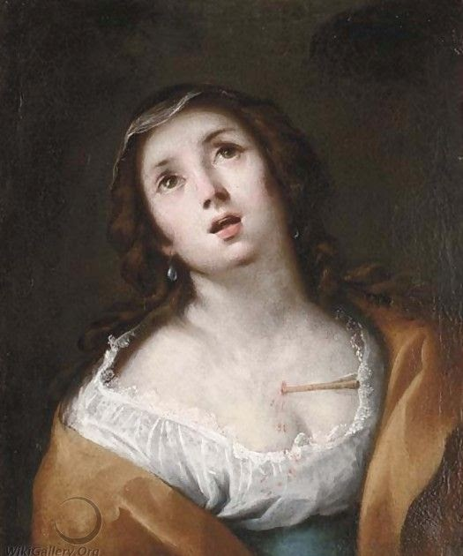
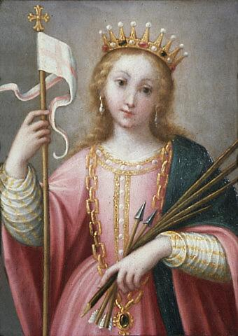
Holiness is a process of conversion
Saint Christina went through a process of conversion…
Wondering about a Creator
Refusing pagan idol worship
Experienced teaching from angels
Declares Christian faith to her father
She responds to God’s invitation by defending her faith to her death
We too are called to conversion
1,6

Slide 10
Companionship of Friends
She is part of the “cloud of Witnesses” = those who have died as martyrs and who bear witness for us
The martyrs robes have been washed in the blood of the Lamb
Christina’s story encouraged the Church community who faced struggle and persecution, Her witness offered hope.
The community shared a common humanity with her. If she could do it, then those in her community said, “I can do it”
It is also an encouragement for us. We too can do it since we are holy, made in the Image of God
1

Slide 11
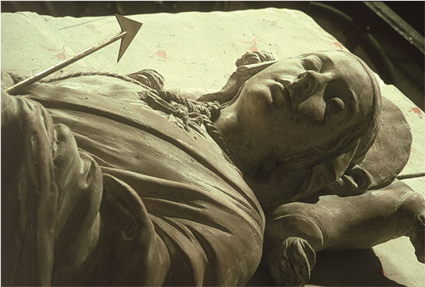
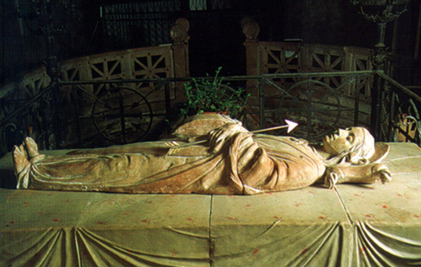
The tomb of St Christina in the Basilica of Saint Christina, Bolsena, Italy. In the center of it, the statue portrays the stone used in the attempt to drown her.
Basilica of Saint Christina
6

Slide 12
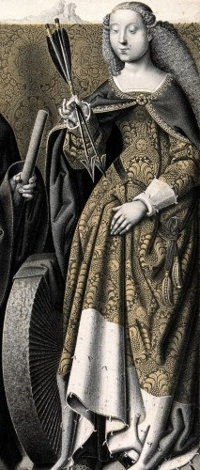
Prayer in Honor of Saint Christine
O Merciful Father in Heaven, who, through the blessed memory of Thy saints, dost desire to stir in our hearts an ardent love for sanctity, we thank Thee for having crowned with the glory of virginity and martyrdom Thy blessed servant, St. Christine.
Let her intercession for us be pleasing and efficacious in Thy sight. Let the memory of her beautiful life and her heroic death bring many souls to follow in her footsteps, that, like her, they may bless Thee eternally; and thou, dear St. Christine, look with favor upon us and obtain for us from God the graces and the blessings we so much stand in need of, and especially the blessings we now implore.
O God, who didst inflame with the spirit of virginal purity, of generous sacrifice and heroic martyrdom the soul of Thy servant, Saint Christine, grant that we may love Thee and serve Thee faithfully to the end, and come to the company of the blessed through the mercy of Him, Who reigns, One God and Three Persons, for ever and ever. Amen.
Bishop Joseph Schrembs’ Prayer in Honor of St. Christine
3, 6

Slide 13
WORKS CITED
1. McCormick, Mary. “Mary & the Saints”, Diocese of Youngstown Diaconate Formation Weekend, 25-26 January 2019, Villa Maria, PA. Lecture.
2. The Catholic Study Bible. New American Bible Revised Edition, 3rd ed., Edited by Donald Senior, John J. Collins, Mary Ann Getty, New York: Oxford University Press, 2010.
3. Prayer in Honor of St. Christine. Joseph Schrembs. Novena to St. Christine, Pamphlet.
4. St. Christina. Catholic Online, 2019, https://www.catholic.org/saints/saint.php?saint_id=148. Accessed 6 February 2019.
5. Paul VI. Dogmatic Constitution on the Church. Lumen Gentium, 21 November 1964,
http://www.vatican.va/archive/hist_councils/ii_vatican_council/documents /vat-ii_const_19641121_lumen-gentium_en.html. Accessed 6 February 2019.
6. Images. Google Images, 2019, https://www.google.com/search?rlz=1C1WPZB_enUS774US774&biw=14 40&bih=758&tbm=isch&sa=1&ei=QetcXLzXHqPl_QbnuaLYCA&q=goog le+images+st.+christina+of+bolsena&oq=google+images+st.+christina +of+bolsena&gs_l=img.12...5365.9818..11924...0.0..1.1013.3079.2j5j1j1j0j 1j0j1......1....1..gws-wiz-img.9yFkhjr5dK4. Accessed 6 February 2019.
7. Martyr Definition. Wikipedia, 2019, https://en.wikipedia.org/wiki/Martyr. Accessed 6 February 2019.

